Slide 1
Senior Year!
Welcome Class of 2020!
Notes:
Jess
‹#›

Slide 2
Notes:
Jess

Slide 3
School Counseling Team
Mrs. Hottle: Health
Mrs. Smith: Engineering, Technology and Manufacturing
Mrs. Wass: IB and Human Services
Mr. Topliff: Arts, Communication, Business
Ms. Houston: English Language Learners
Ms. Watters: Performance Based Diploma
Mrs. Kleinendorst: Counseling Office Manager….helps all students
Stella Lwin & Nicole Turner: Co op students
Notes:
Jess
‹#›

Slide 4



Announcements
Twitter
Student Symbaloo
West Website
Notes:
Jess

Slide 5
Senior Handbook
Located on West High website under “Counseling Services” tab.
Notes:
Jess-show on website as well as how to book an appointment.
‹#›

Slide 6
FOR YOUR CALENDAR
Notes:
Jess

Slide 7
SENIOR PICTURES
January 6: deadline for submission to yearbook
Check “Student Life” tab and scroll down to “Yearbook” on Website
Notes:
Jess-show on website
‹#›

Slide 8
SENIOR HONORS PROGRAM
Program is scheduled for 12:30 PM, May 8th.
Info emailed to Mr. Topliff by May 1.
  topliffr@waterlooschools.org
Invitations are sent to parents of students who will be honored on stage.
Notes:
Jess
‹#›

Slide 9
Graduation
Friday, May 22, 2020
McLeod Center
6:00 p.m.
Notes:
Jess

Slide 10
UNI ETS
Educational Talent Search: free service helping students with many “transition to college” services. (applications in Counseling office)
  ACT Registration
  Tutoring
  College Visits
  College Applications
  Financial Aid Applications
  Scholarship Applications
Notes:
Jess
Melissa Tate- 10-12 grade, basically every day except Friday in Commons or IMC
Carlos Frazier or Janet Priemer--share 9th grade
Applications in our office
Parents have to still sign records release every year for them to meet with you.
‹#›

Slide 11
Academic Progress
USE THIS GREAT TOOL TO MAKE SURE YOU ARE ON TRACK TO GRADUATE
Notes:
Ryan

Slide 12
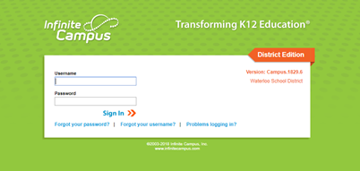
Academic Progress
Step one: Login to your infinite campus
Notes:
Ryan

Slide 13
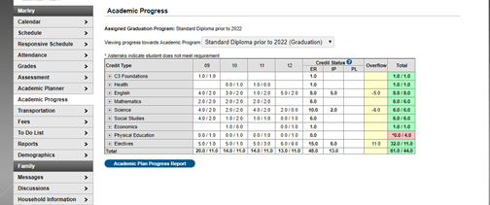
Academic Progress
Notes:
Ryan- explain ER and IP and overflow.

Slide 14
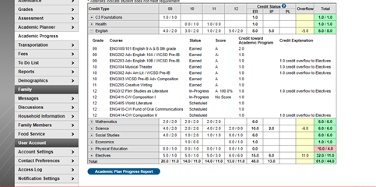
Academic Progress
Notes:
Ryan - click on expand boxes to see everything in that category

Slide 15
Selective Service Registration
Men required to register when you turn 18, but can register earlier (17 years 3 months).
Registration forms located at US Post Offices or online (sss.gov).
Is required in order to be eligible for financial aid that is provided for/subsidized by Federal Government.
Notes:
Sex assigned at birth
Ryan - THIS IS REQUIRED TO BE ELIGIBLE FOR FINANCIAL AID
‹#›

Slide 16

NCAA Eligibility Center
Athletes: If planning to compete at Division I or II institution, you MUST register with the NCAA Eligibility Center www.eligibilitycenter.org.
Cost: $90 (domestic/Canada) $150 (international)
Payment will require a debit or credit card.
Notes:
Please do this ASAP!
Ryan
‹#›

Slide 17
PSEO & Concurrent Courses
College classes taken while in high school
Assessment scores needed for some courses
REGISTRATION=NOVEMBER 12
Must have all paperwork for classes on Hawkeye CC campus completed by the November 29th deadline.
NO EXCEPTIONS!
Notes:
Brooke - This is only for second semester of this year. They have to be approved to have classes outside of West Campus. The paperwork is lengthy so don’t wait until the last minute.

Slide 18
College Reps and Military Recruiter Visits
Listen to the announcements, check out TVs, or go to twitter.com and search for @west_counseling for visit dates.
Student sign up with Mrs. Kleinendorst in the Counseling Office, as you will receive a pass.
Notes:
Brooke

Slide 19
College Campus Visits
You are encouraged to visit schools which you are considering.
Contact the admissions office of the school in which you are interested or sign up online.
Parents/Guardians, please contact our Attendance Office prior to the college visit.
Notes:
Brooke
‹#›

Slide 20
POST-SECONDARY INSTITUTIONS
Notes:
Sheila
‹#›

Slide 21
College Entrance Exams
ACT or SAT: Check with the 4-year colleges in which you are interested to see which test they prefer. ACT is accepted almost everywhere.
Registration date information available in Counseling Office. Student is responsible for registration. Next Fall ACT test date: Dec 14 (www.act.org)
Assistance from Melissa (Talent Search) prior to each deadline in our IMC
ACCUPLACER: Most 2-year schools utilize this as their entrance/placement exam.
Notes:
Sheila Say: November 8 is deadline for December 14 to register for ACT test…
‹#›

Slide 22
College/Scholarship Application Help Sessions
OCTOBER= College Application Month/FSA ID
DECEMBER=Scholarship Search/FAFSA Help
Create a resume as you will need this for applications, letters of recommendation, etc.
Notes:
Sheila
‹#›

Slide 23
College Representatives coming to West High Media Center
Iowa Central- October 3, 1:00pm
Luther- October 3, 1:30pm
University of Iowa- October 9, 1:00pm
Mount Mercy- October 10, 1:15pm
University of Dubuque- October 11, 1:15pm\
Truman University- October 21, 12:30pm
Drake- October 25, 9:00am
**Sign up in Counseling Services so a pass can be sent to you.**
Notes:
Sheila
Please check our website for more upcoming dates.

Slide 24
Letters of Recommendation
Check to see if the school or scholarship requires letters of recommendation.
Ask adults who know you well (not relatives) to write a general letter of recommendation.
Provide those people with your resume so that they can fully comment on your qualifications.
GIVE PLENTY OF NOTICE!
Write a thank you note!
Notes:
Sheila
‹#›

Slide 25
TRANSCRIPTS
Transcript Request Forms are in Counseling Services Office.
Transcript must come from West to be “official.”
Notes:
Sheila- if 18 do not need parent signature
‹#›

Slide 26
FINANCIAL AID
Start early and check often
Notes:
Marsha
‹#›

Slide 27
What is Financial Aid?
Gift Aid:
  Grants: need-based aid
  Scholarships: merit, athletics, extracurriculars, etc.
Self-Help Aid
  Loans: borrowed money that must be repaid
    Government
    Private
  Work Study: money earned from need-based employment
Notes:
Marsha

Slide 28

Financial Aid
Must complete the FAFSA (Free Application for Federal Student Aid) to receive financial aid. Available online October 1. www.fafsa.ed.gov
(2018 tax information)
Notes:
Marsha

Slide 29
Iowa College Access Network (ICAN)
The high school class of 2017 left as much as $2.3 billion in free federal grant money for college on the table, according to a new analysis by NerdWallet. Free money went unclaimed due to students not completing or submitting the Free Application for Federal Student Aid.
The Initiative
FAFSA Ready Iowa aims to increase FAFSA completion in Iowa to 70% by 2025.
ICAN, the sponsor of FAFSA Ready Iowa, operates nine student success centers statewide offering FREE FAFSA completion assistance.
Notes:
Iowa's current FAFSA completion rate averages around 63 percent.
Marsha

Slide 30
Local Financial Aid Assistance- FAFSA Ready Iowa
John Holland with ICAN at West High
October 29 & November 12
3:30pm, 4:30pm, 5:30pm (choose one specific appt)
https://www.schedulicity.com/scheduling/ICARUB/workshops
Melissa Tate with Education Talent Search (ETS) at West High
Tuesday, October 22
3:00pm-6:30pm
No appointment needed. Open to all!
ICAN (with John Holland)
UNI-CUE 800 Sycamore St or Hawkeye CC, Waterloo
Oct 1, 2019-March 15, 2020
By appointment-- Visit www.icansucceed.org/apt
Notes:
Marsha

Slide 31
Follow social media sites...
Follow ICAN:
Facebook – www.facebook.com/icansucceed
Twitter - @icansucceed
Instagram - iowacollegeaccess
Follow FAFSA Ready Iowa:
Twitter - @fafsareadyia
Notes:
Marsha

Slide 32
Financial Aid
When should I file?
The 2020-2021 FAFSA form will be available October 1, 2019.
Each college has a priority deadline for the FAFSA. You should file the FAFSA before the priority deadline. If you are applying to multiple schools, file by the earliest deadline.
Notes:
Marsha- U of Iowa, & Iowa State, Dec 1st---UNI, Jan 15th
State deadline is July 1st
May miss out on state & institution aid & fed funds

Slide 33
Scholarships
All scholarships through our office are posted under the “Counseling Services” tab on the West High Website.
Scholarships are updated continuously-check often!
Be wary of any organization which claims, in exchange for a fee, to assist in obtaining scholarship money.
Many, many options are free!
Notes:
Kisha-show website location

Slide 34
Opportunities from Iowa Student Loan
Save Now, Save Later: College Savings Plan Parent Giveaway
The Save Now, Save Later: College Savings Plan Parent Giveaway opened to parents/guardians of Iowa students in grades 6–12.
Awards: Fifty $1,000 deposits into College Savings Iowa accounts.
Open to: Parents and guardians of Iowa students in grades 6–12.
Requirements: Visit the new Parent Handbook guide for important college financing information and enter contact information to register.
Start at: www.IowaStudentLoan.org/SaveNow
Notes:
Kisha

Slide 35
Opportunities from Iowa Student Loan
Oct. 15–Feb. 21: Iowa Financial Know-How Challenge: Senior Scholarship
Open to: Iowa high school seniors who will attend college in fall 2020.
Awards: Thirty $2,000 college scholarships plus $500 to each recipient's high school.
Requirements: Register online and then follow emailed instructions to complete two online components and a related assessment. Essays may be required as a tiebreaker.
Start at: www.IowaStudentLoan.org/SeniorScholarship
Notes:
Kisha

Slide 36
Opportunities from Iowa Student Loan
March 16-April 30: College Funding Forecaster Giveaway
Open to: Iowa high school students & their parents or guardians.
Awards: Weekly drawings for educational expense awards plus two college scholarships for high school seniors attending college in fall 2020.
Requirements: Complete the College Funding Forecaster tool to estimate total college costs over four years and enter contact information to register.
Start at: www.IowaStudentLoan.org/Giveaway
Notes:
Kisha

Slide 37
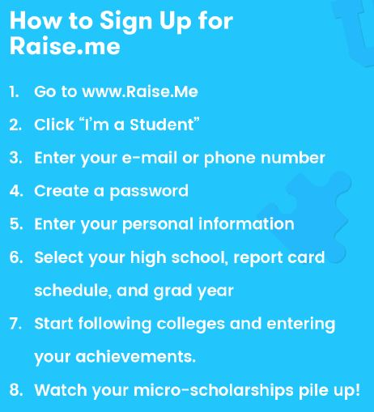
RAISE.ME
Notes:
Kisha--give examples of Raise.me...World Language, High GPA, taking ACT, extracurriculars, etc.

Slide 38
GRADUATION
Think ahead:
Many things to take care of……
Notes:
Marsha
‹#›

Slide 39
Dates, dates, dates!
Seniors: Watch TV monitors, view our website, Counseling Services tile on Student Symbaloo & check Twitter daily during your senior year. Dates included in your senior handbook are accurate as of the time of posting; these may change.
THINK AHEAD!
Notes:
Marsha
‹#›

Slide 40
Mid-Year/January Graduates
January 16: end of 1st semester.
CAN participate in: Prom, Post-Prom, and Commencement.
CANNOT participate in: athletics, band, dances, theater productions, other school activities.
Must pick up a Check-Out Sheet in
Counseling Services to take to teachers.
All-Clear Card from Business Office.
No records sent unless you have correctly checked out and taken care of financial issues.
Notes:
Marsha
‹#›

Slide 41
DIPLOMA
Complete a Post Grad Intent Form before Winter Break with Counselor.---preferably in October. We will include student legal name on diploma as indicated in Infinite Campus.
A list will be posted with diploma spellings. Check this list. If incorrect, you must correct it. If an incorrect diploma is printed, you will be responsible for the cost ($15) of the reprinted diploma.
Notes:
Marsha
‹#›

Slide 42
HONORS DIPLOMA CREDIT REQUIREMENTS
STANDARD DIPLOMA PLUS
Honors Diploma Credits for Graduation 53+
Notes:
Marsha

Slide 43
Additionally, to earn an Honors Diploma, students must also successfully complete five advanced courses from PSEO (Post Secondary Enrollment Option), AP (Advanced Placement), IB (International Baccalaureate), and/or Concurrent Courses, which can include CTE (Career Technical Education) courses. The five advanced courses must be year-long courses. Semester courses would count as .5 in meeting the requirement of five advanced courses.
Notes:
Marsha

Slide 44
GRADUATION ITEMS
Measurements and orders taken during Parent-Teacher Conferences on October 17, 12- 8pm. Deposit required.
Cannot pick up Cap & Gown until on official Graduation List (May).
Notes:
Marsha (Matt McManus will be here during Senior Meeting on Wednesday)
‹#›

Slide 45
Official Graduation List
Will be posted in May
Requirements to be on list:
  Passing all classes needed for graduation
  All online courses COMPLETED
  Detention served
  Fines/Fees paid
Notes:
Marsha
‹#›

Slide 46
COMMENCEMENT
McLeod Center (UNI): Friday, May 22 at 6:00 PM
MANDATORY practice will be held at the McLeod Center at 9:00 AM on Friday, May 22
Must take part in the entire graduation practice in order to be in the actual ceremony
Notes:
Marsha

Slide 47
Commencement Dress Code
  Dress shoes or sandals (NO flip flops and NO cowboy boots)
  Dress Pants/Slacks/dress (NO jeans)
  Dress shoes (NO white soles and NO tennis shoes)
  Absolutely no writing allowed on caps.
Notes:
Marsha
‹#›

Slide 48
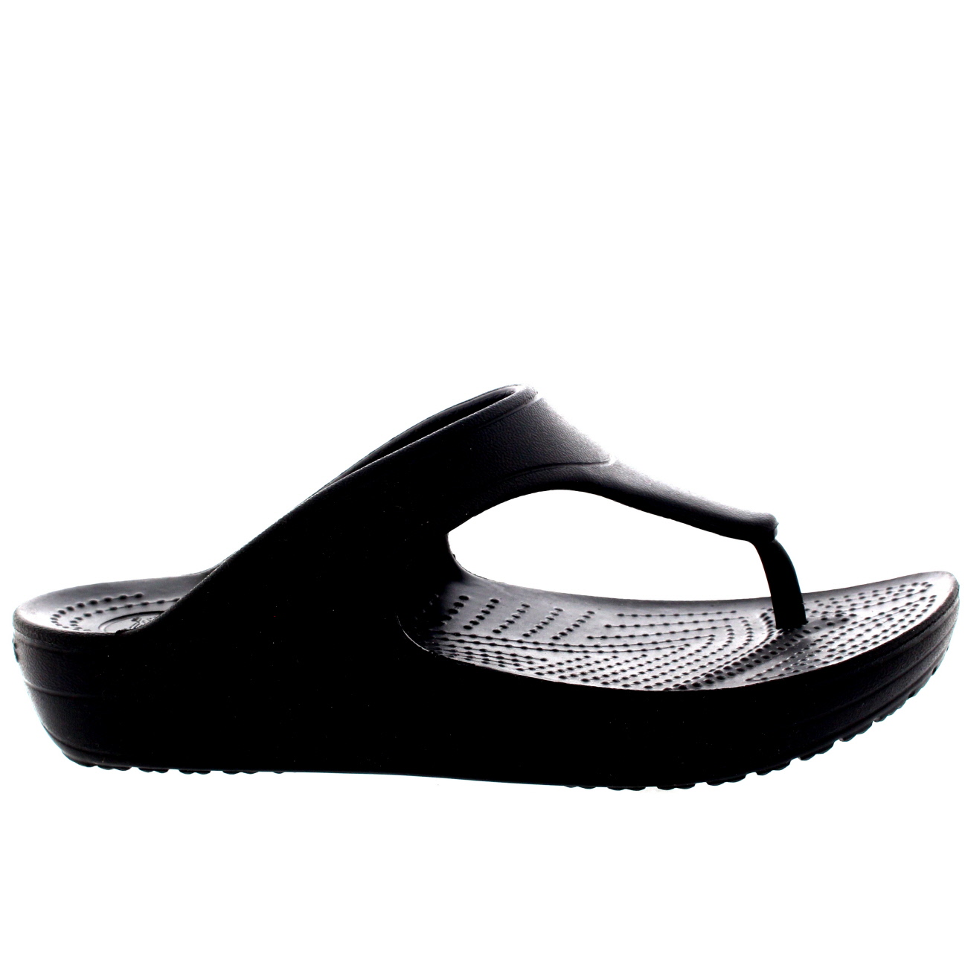

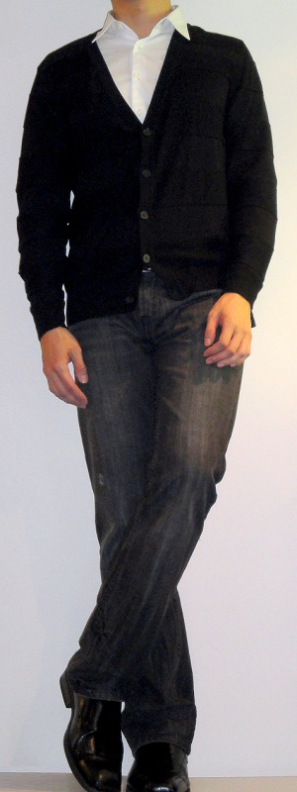
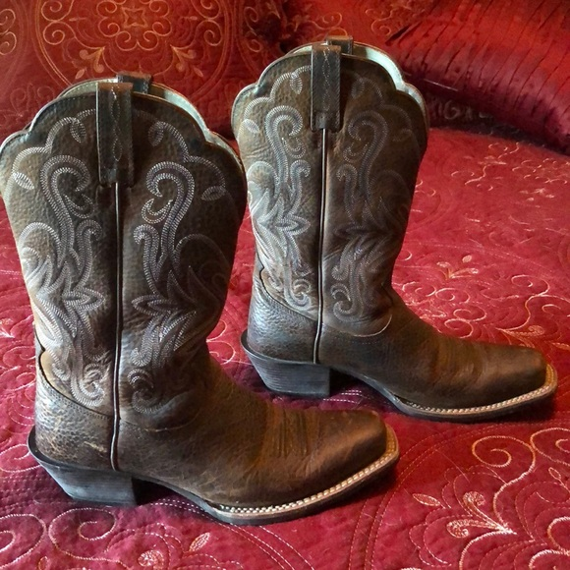

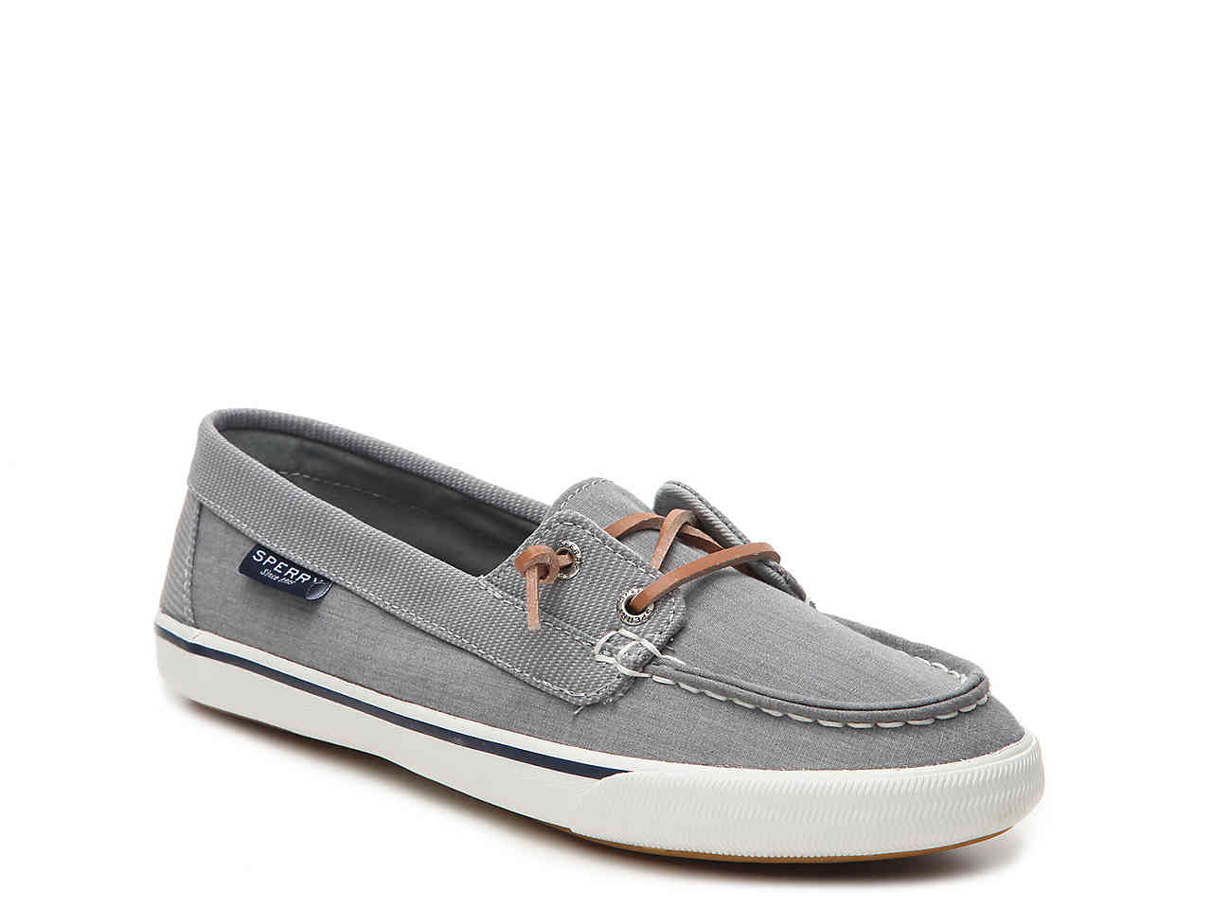
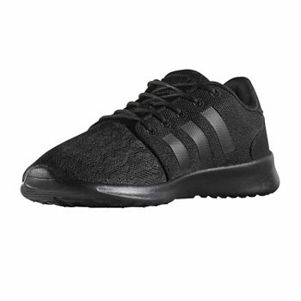
Pictures of examples of what NOT to wear
Notes:
Marsha

Slide 49

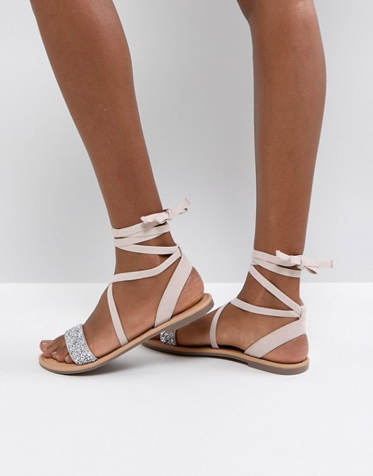
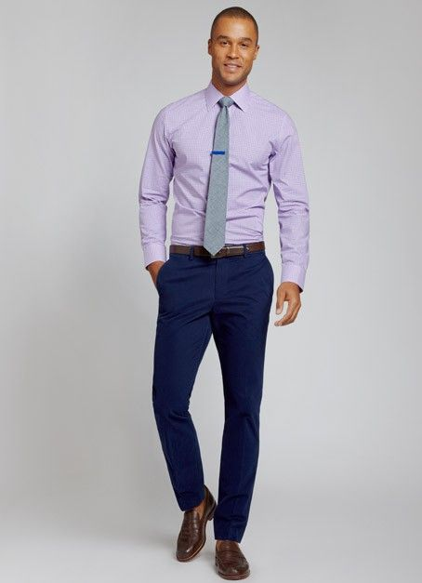

Pictures of examples of what you CAN wear
Notes:
Marsha

Slide 50
Thank you for attending!
If you have questions, please make an appointment with your counselor.
We are here to help you successfully complete your year. We want to help you with your post high school plans, including college & scholarship applications!
Pay attention to announcements and deadlines!
Notes:
Marsha
‹#›

Slide 51
Start Strong!
Finish Stronger!
Notes:
‹#›

