Slide 1
Senior Year!
Welcome Class of 2019!
Notes:
Jess
‹#›

Slide 2
School Counseling Team
Mrs. Lilja: IB and Health Academy
Mrs. Smith: Engineering, Technology and Manufacturing
Mrs. Wass: Human Services Academy
Mr. Topliff: Arts, Communication, Business Academy
Mrs. Houston: English Language Learners
Ms. Watters: Performance Based Diploma Academy
Mrs. Kleinendorst: Counseling Office Manager….helps all students
Notes:
Jess
‹#›

Slide 3
Announcements
Twitter
  https://twitter.com/West_Counseling
Website
  http://www.waterlooschools.org/schoolsites/westhigh/
Notes:
Jess

Slide 4
Senior Handbook
Located on West High website under “Counseling Services” tab.
Notes:
Jess-show on website as well as how to book an appointment.
‹#›

Slide 5
FOR YOUR CALENDAR
Notes:
Jess

Slide 6
SENIOR PICTURES
November 1: deadline for submission to yearbook
Check “Student Life” tab and scroll down to “Yearbook” on Website
Notes:
Jess
‹#›

Slide 7
SENIOR HONORS PROGRAM
Program is scheduled for 12:30 PM, May 10th.
Info emailed to Mr. Topliff by May 1.
Invitations are sent to parents of students who will be honored on stage.
Notes:
Jess
‹#›

Slide 8
Graduation
Tuesday, May 28, 2019
McLeod Center
6:00 p.m.
Notes:
Jess

Slide 9
UNI ETS
Educational Talent Search: free service helping students with many “transition to college” services. (applications in Counseling office)
  ACT Registration
  Tutoring
  College Visits
  College Applications
  Financial Aid Applications
  Scholarship Applications
Notes:
Jess
Cliff Coney-juniors & seniors, basically every day except Friday in the library
Lori Dale-freshmen & sophomores
Applications in our office
Parents have to still sign records release every year for them to meet with you.
‹#›

Slide 10
Academic Progress
USE THIS GREAT TOOL TO MAKE SURE YOU ARE ON TRACK TO GRADUATE
Notes:
Ryan

Slide 11
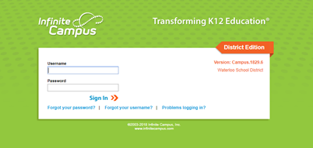
Academic Progress
Step one: Login to your infinite campus
Notes:
Ryan

Slide 12
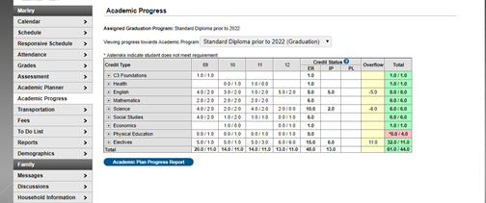
Academic Progress
Notes:
Ryan- explain ER and IP and overflow.

Slide 13
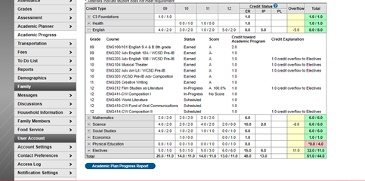
Academic Progress
Notes:
Ryan - click on expand boxes to see everything in that category

Slide 14
Selective Service Registration
Men required to register when you turn 18, but can register earlier (17 years 3 months).
Registration forms located at US Post Offices or online (sss.gov).
Is required in order to be eligible for financial aid that is provided for/subsidized by Federal Government.
Notes:
Sex assigned at birth
Ryan - THIS IS REQUIRED TO BE ELIGIBLE FOR FINANCIAL AID
‹#›

Slide 15

NCAA Eligibility Center
Athletes: If planning to compete at Division I or II institution, you MUST register with the NCAA Eligibility Center www.eligibilitycenter.org.
Cost: $90 (domestic/Canada) $150 (international)
Payment will require a debit or credit card.
Notes:
Please do this ASAP!
Ryan
‹#›

Slide 16
PSEO & Concurrent Courses
College classes taken while in high school
IA Assessment scores needed
REGISTRATION=NOVEMBER 7
Must have all paperwork for classes on Hawkeye CC campus completed by the November 30th deadline.
NO EXCEPTIONS!
Notes:
Ryan - This is only for second semester of this year. They have to be approved to have classes outside of West Campus. The paperwork is lengthly so don’t wait until the last minute.

Slide 17
College Reps and Military Recruiter Visits
Listen to the announcements, check out TVs, or go to twitter.com and search for @west_counseling for visit dates.
Student sign up with Mrs. Kleinendorst in the Counseling Office.
Notes:
Ryan

Slide 18
College Campus Visits
You are encouraged to visit schools which you are considering.
Contact the admissions office of the school in which you are interested or sign up online.
Parents/Guardians, please contact our Attendance Office prior to the college visit.
Notes:
Ryan
‹#›

Slide 19
POST-SECONDARY INSTITUTIONS
Notes:
Kisha
‹#›

Slide 20
College Entrance Exams
ACT or SAT: Check with the 4-year colleges in which you are interested to see which test they prefer. ACT is accepted almost everywhere.
Registration date information available in Counseling Office. Student is responsible for registration. Fall ACT test dates: 10/27 12/08 (www.act.org)
ACCUPLACER: Most 2-year schools utilize this as their entrance/placement exam. Thursday, 10/25 at 9:00 AM
Notes:
KISHA Say: September 28 is deadline for October 27 & November 2 is deadline to register for 12/8 ACT test…
Say: Sign up in counseling office by October 22 for the ACCUPLACER
Kisha
‹#›

Slide 21
College/Scholarship Application Help Sessions
OCTOBER= College Application Month
DECEMBER=Scholarship Search/FAFSA Help
Create a resume as you will need this for applications, letters of recommendation, etc.
Notes:
Kisha
‹#›

Slide 22
College Representatives coming to West High Media Center
Northern Illinois University-Sept. 25
Drake-Sept. 26
Central College-Oct. 1
Wartburg-Oct. 2
CAPRI College-Oct. 9
University of Iowa-Oct. 11
Upper Iowa-Oct. 17
University of Dubuque-Oct. 30
Valparaiso University-Nov. 1
Notes:
Kisha
Please check our website for more upcoming dates.

Slide 23
Letters of Recommendation
Check to see if the school or scholarship requires letters of recommendation.
Ask adults who know you well (not relatives) to write a general letter of recommendation.
Provide those people with your resume so that they can fully comment on your qualifications.
GIVE PLENTY OF NOTICE!
Write a thank you note!
Notes:
Kisha
‹#›

Slide 24
TRANSCRIPTS
Transcript Request Forms are in Counseling Services Office.
Transcript must come from West to be “official.”
Notes:
Kisha- if 18 do not need parent signature
‹#›

Slide 25
FINANCIAL AID
Start early and check often
Notes:
Marsha
‹#›

Slide 26
What is Financial Aid?
Gift Aid:
  Grants: need-based aid
  Scholarships: merit, athletics, extracurriculars, etc.
Self-Help Aid
  Loans: borrowed money that must be repaid
    Government
    Private
  Work Study: money earned from need-based employment
Notes:
Marsha

Slide 27

Financial Aid
Must complete the FAFSA (Free Application for Federal Student Aid) to receive financial aid. Available online October 1. www.fafsa.ed.gov
(2017 tax information)
Notes:
Marsha

Slide 28
Iowa College Access Network (ICAN)
Iowans left nearly $25 million in grants & scholarships by not completing the FAFSA in 2015-16.
The Initiative
FAFSA Ready Iowa aims to increase FAFSA completion in Iowa to 70% by 2025.
The Iowa College Access Network (ICAN), the sponsor of FAFSA Ready Iowa, operates nine student success centers statewide offering FREE FAFSA completion assistance.
Notes:
Iowa's current FAFSA completion rate averages around 63 percent.
Marsha

Slide 29
Local Financial Aid Assistance- FAFSA Ready Iowa
John Holland with ICAN at West High
November 13, 2018, December 4, 2018 & January 15, 2019
4:00pm, 5:00pm, 6:00pm (choose one specific appt)
Up to three families per hour.
Melissa Tate with Education Talent Search (ETS) at West High
December 11, 2018
4:00pm-7:00pm
No appointment needed.
ICAN (with John Holland)
UNI-CUE 800 Sycamore St, Waterloo
Oct 1, 2018-March 15, 2019
By appointment-- Visit www.icansucceed.org/apt
Notes:
Marsha

Slide 30
Follow social media sites...
Follow ICAN:
Facebook – www.facebook.com/icansucceed
Twitter - @icansucceed
Instagram - iowacollegeaccess
Follow FAFSA Ready Iowa:
Twitter - @fafsareadyia
Notes:
Marsha

Slide 31
Financial Aid
When should I file?
The 2019-20 FAFSA form will be available October 1, 2018.
Each college has a priority deadline for the FAFSA. You should file the FAFSA before the priority deadline. If you are applying to multiple schools, file by the earliest deadline.
Notes:
Marsha- U of Iowa, & Iowa State, Dec 1st---UNI, Jan 15th
State deadline is July 1st
May miss out on state & institution aid & fed funds

Slide 32
Scholarships
All scholarships through our office are posted under the “Counseling Services” tab on the West High Website.
Scholarships are updated continuously-check often!
Be wary of any organization which claims, in exchange for a fee, to assist in obtaining scholarship money.
Many, many options are free!
Notes:
Kisha-show website location

Slide 33
Opportunities from Iowa Student Loan
Save Now, Save Later: College Savings Plan Parent Giveaway
The Save Now, Save Later: College Savings Plan Parent Giveaway opened to parents/guardians of Iowa students in grades 6–12.
Awards: Fifty $1,000 deposits into College Savings Iowa accounts.
Open to: Parents and guardians of Iowa students in grades 6–12.
Requirements: Visit the new Parent Handbook guide for important college financing information and enter contact information to register.
Start at: www.IowaStudentLoan.org/SaveNow
Notes:
Kisha

Slide 34
Opportunities from Iowa Student Loan
Oct. 22–Feb. 22: Iowa Financial Know-How Challenge: Senior Scholarship
Open to: Iowa high school seniors who will attend college in fall 2019.
Awards: Thirty $2,000 college scholarships plus $500 to each recipient's high school.
Requirements: Register online and then follow emailed instructions to complete two online components and a related assessment. Essays may be required as a tiebreaker.
Start at: www.IowaStudentLoan.org/SeniorScholarship
Notes:
Kisha

Slide 35
Opportunities from Iowa Student Loan
March 18: College Funding Forecaster Giveaway
Open to: Iowa high school students & their parents or guardians.
Awards: Weekly drawings for educational expense awards plus two college scholarships for high school seniors attending college in fall 2019.
Requirements: Complete the College Funding Forecaster tool to estimate total college costs over four years and enter contact information to register.
Start at: www.IowaStudentLoan.org/Giveaway
Notes:
Kisha

Slide 36
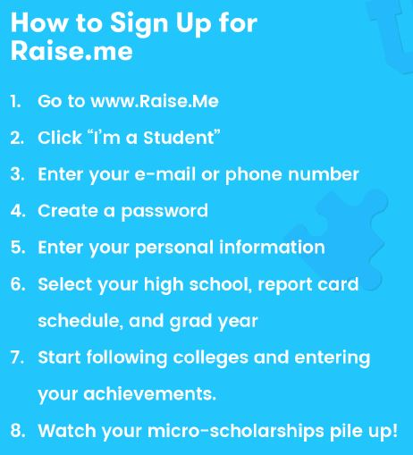
RAISE.ME
Notes:
Kisha

Slide 37
GRADUATION
Think ahead:
Many things to take care of……
Notes:
Marsha
‹#›

Slide 38
Dates, dates, dates!
Seniors: Watch TV monitors, view our website & check Twitter daily during your senior year. Dates included in your senior handbook are accurate as of the time of posting; these may change.
THINK AHEAD!
Notes:
Marsha
‹#›

Slide 39
Mid-Year/January Graduates
January 17: end of 1st semester.
CAN participate in: Prom, Post-Prom, and Commencement.
CANNOT participate in: athletics, band, dances, theater productions, other school activities.
Must pick up a Check-Out Sheet in
Counseling Services to take to teachers and the library.
All-Clear Card from Business Office.
No records sent unless you have correctly checked out and taken care of financial issues.
Notes:
Marsha
‹#›

Slide 40
DIPLOMA
Complete a Post Grad Intent Form in December with Counselor. Will include student legal name on diploma as indicated in In.
A list will be posted with diploma spellings. Check this list. If incorrect, you must correct it. If an incorrect diploma is printed, you will be responsible for the cost ($15) of the reprinted diploma.
Notes:
Marsha
‹#›

Slide 41
GRADUATION ITEMS
Measurements and orders taken during Parent-Teacher Conferences on October 23 & 25. Deposit required.
Cannot pick up Cap & Gown until on official Graduation List.
Notes:
Marsha (Matt McManus will be here)
‹#›

Slide 42
Official Graduation List
Will be posted in May.
Requirements to be on list:
  Iowa Assessment score-263 on Reading & Math
  Passing all classes needed for graduation
  All on-line courses COMPLETED
  Detention served
  Fines/Fees paid
Notes:
Marsha
‹#›

Slide 43
COMMENCEMENT
McLeod Center (UNI): Tuesday, May 28 at 6:00 PM
MANDATORY practice will be held at the McLeod Center at 9:00 AM on Tuesday, May 28
Must take part in the entire graduation practice in order to be in the actual ceremony
Notes:
Marsha

Slide 44
Commencement Dress Code
Women
  Nice pants/dress
  Dress shoes or sandals (NO flip flops)
  Men
  Dress Pants/Slacks (NO jeans)
  Dress shoes (NO white soles)
  Absolutely no writing allowed on caps.
Notes:
Marsha
‹#›

Slide 45
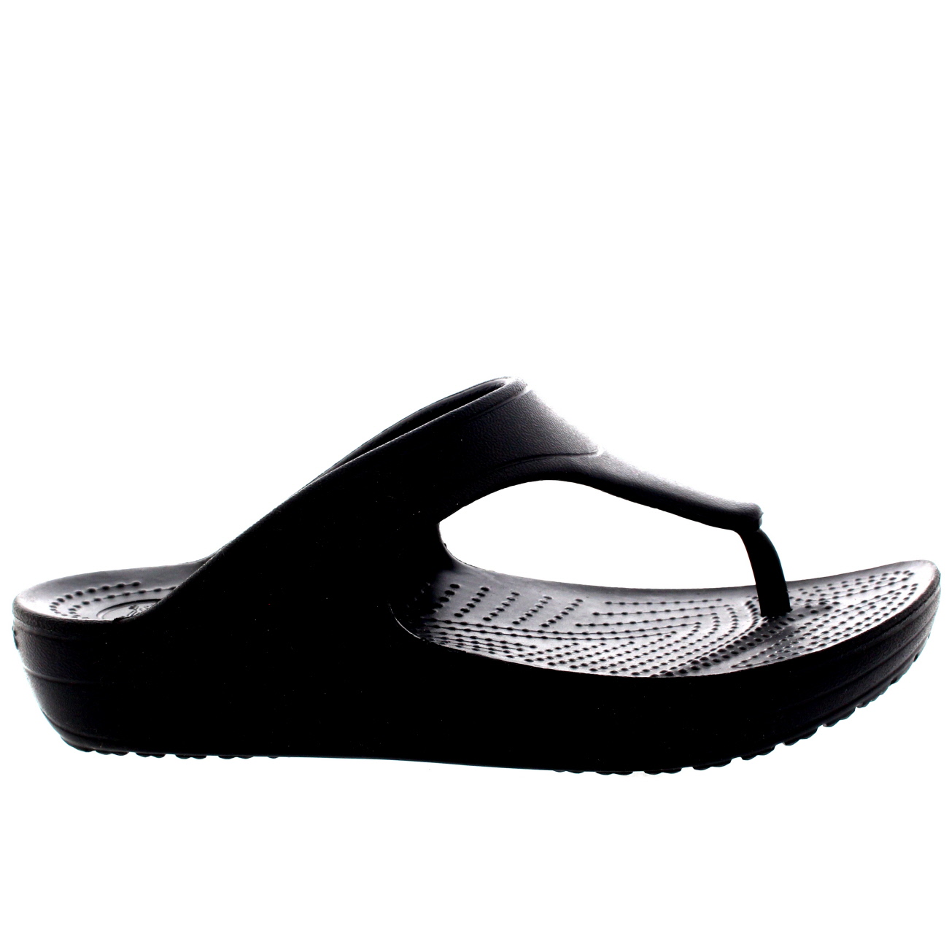

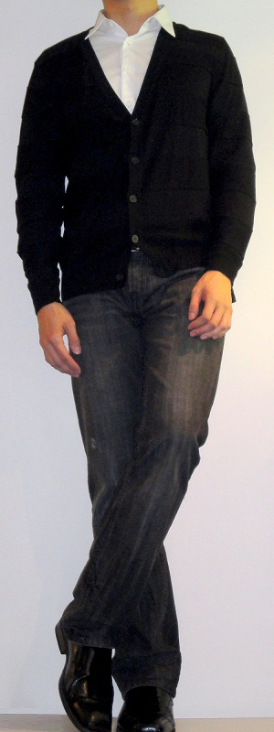


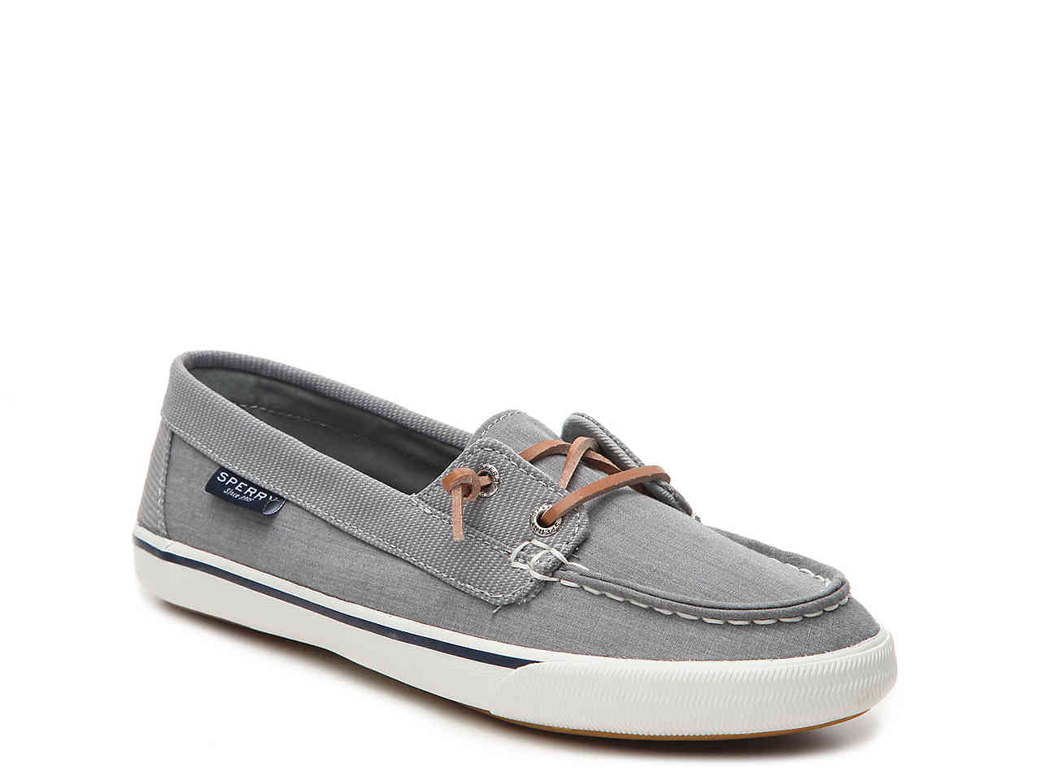
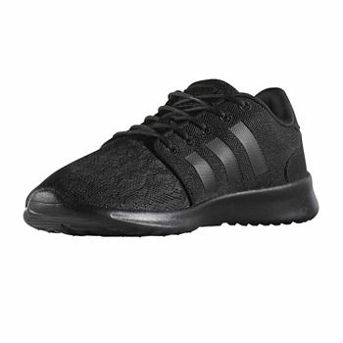
Pictures of examples of what NOT to wear
Notes:
Marsha

Slide 46
Thank you for attending!
If you have questions, please make an appointment with your counselor.
We are here to help you successfully complete your year. We want to help you with college & scholarship applications!
Pay attention to announcements and deadlines!
Notes:
Marsha
‹#›

Slide 47
Start Strong!
Finish Stronger!
Notes:
‹#›

